Slide 1
TECHNOLOGY AND ALGORITHMS: A SOLUTION TO BEE´S EXTINTION
Isabella Arango Restrepo
Juan David Rengifo Castro
Medellín, Date of the oral presentation

Slide 2
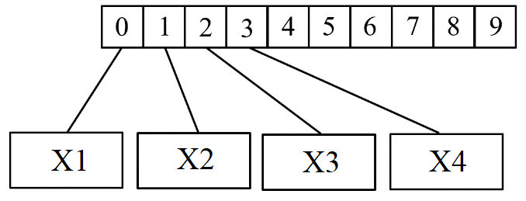
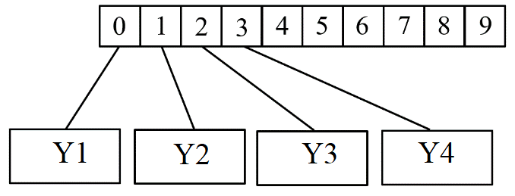
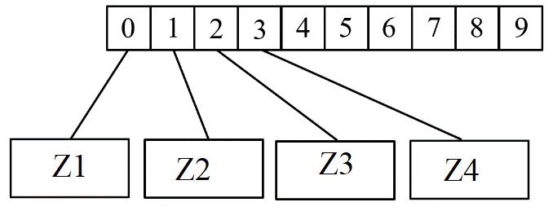
Estructuras de Datos Diseñada
Graphic 1: ArrayList of bee´s coordinates. A coordinate is double number that represent the latitude, longitude or height.

Slide 3
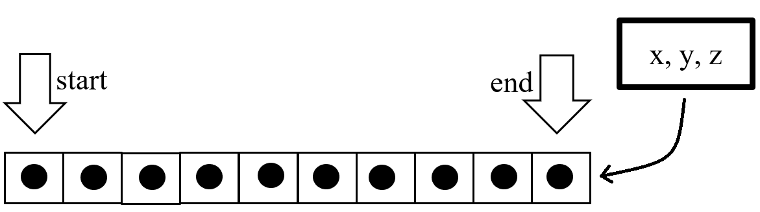
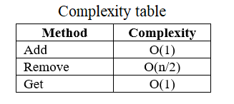
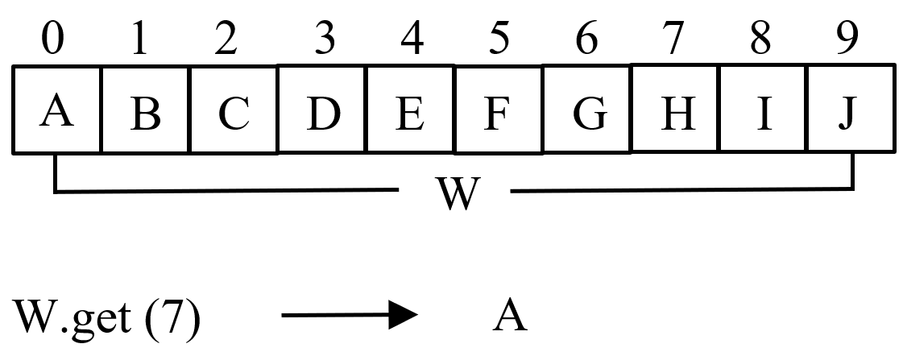
Data Structure Operations
Graphic 2: Add operation of ArrayLists.
Table 1: Complexity of the operations of ArrayLists.
Graphic 3: Get operation of ArrayLists.

Slide 4
Design Criteria of the Data Structure
To solve the problem it was necessary to test it with groups of data of different sizes, that is to say that this was not a constant factor.
The data structure used should be one to which you could add many data and obtain each of its specifications (length, latitude, height).
The add and get operation in an ArrayList have time complexity of O(1), so they were very efficient no matter the size of the data.

Slide 5
Time and Memory Consumption
Graphic 4, 5: Time execution for add operation in ArrayLists of different lengths.

Slide 6
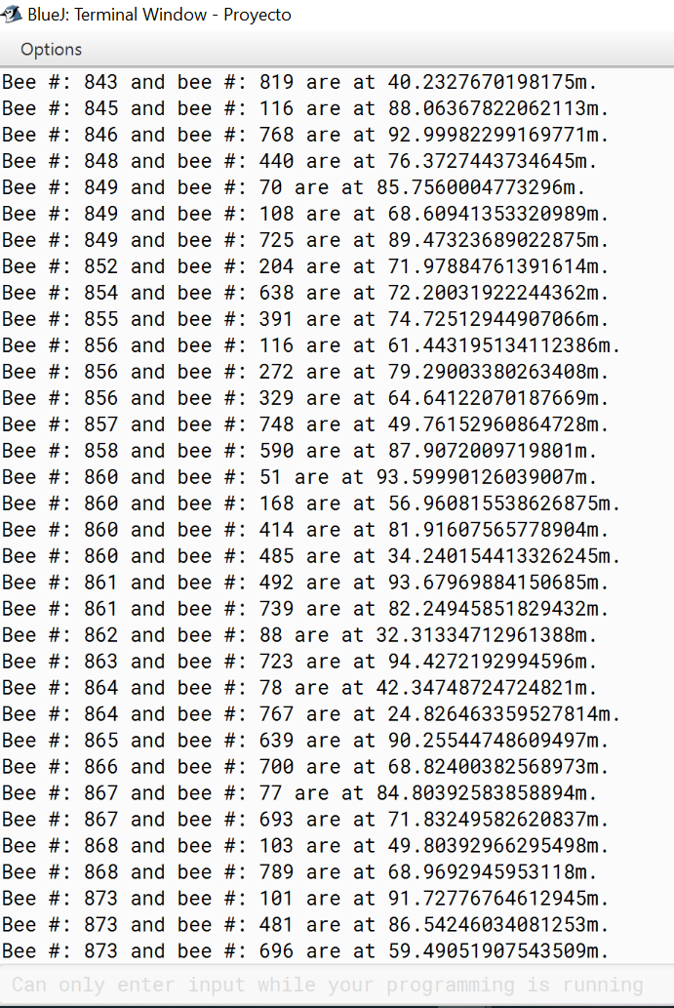
Implementation
Graphic 5: Bees that are less than 100m.

